Slide 1
Migration to github

Slide 2
Current status
Code repository:
svn.deepskylog.org
Issues and wiki:
redmine.deepskylog.org
New release:
whenever we feel ready.
Maintenance time needed

Slide 3
GitHub
Largest code hoster in the world
From Google to the White house, everybody is on GitHub
Let’s be honest - if you’re not hosting your source code on GitHub right now, your open source project pretty much doesn’t exist
Lot’s of documentation on how to use:
https://training.github.com/kit/
https://training.github.com/classes/

Slide 4
GitHub
Documentation
in easy-to-use Markdown format
Issue tracking
Wiki
Social development

Slide 5
Git Workflow
Fork repository
Branch code
Work locally on the code
Merge code with latest code from DeepskyLog
Push code to own account

Slide 6
Git Workflow
Pull request
Discuss changes
Merge them to master repository
Master repository is always in a working state

Slide 7
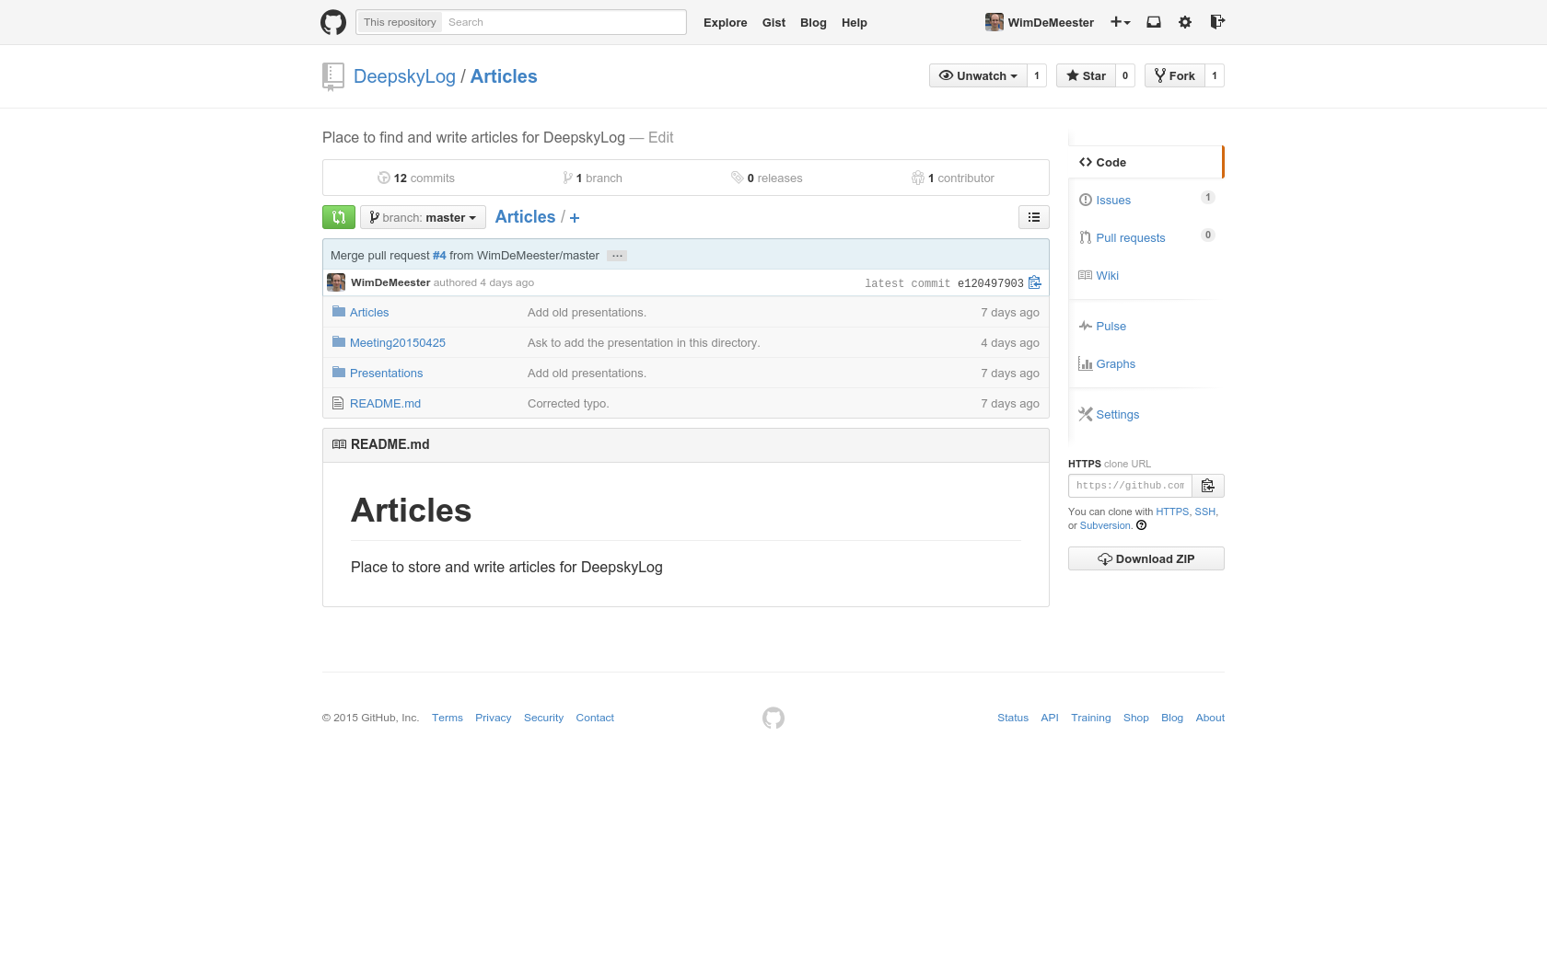

Slide 8
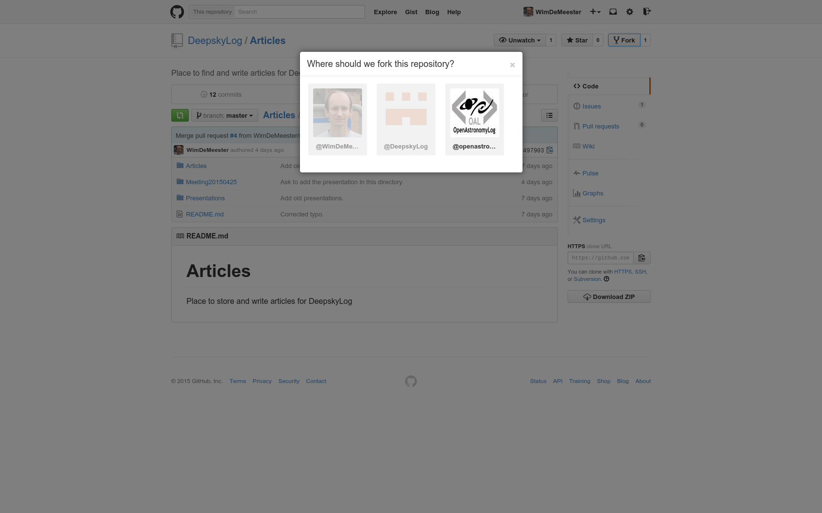

Slide 9
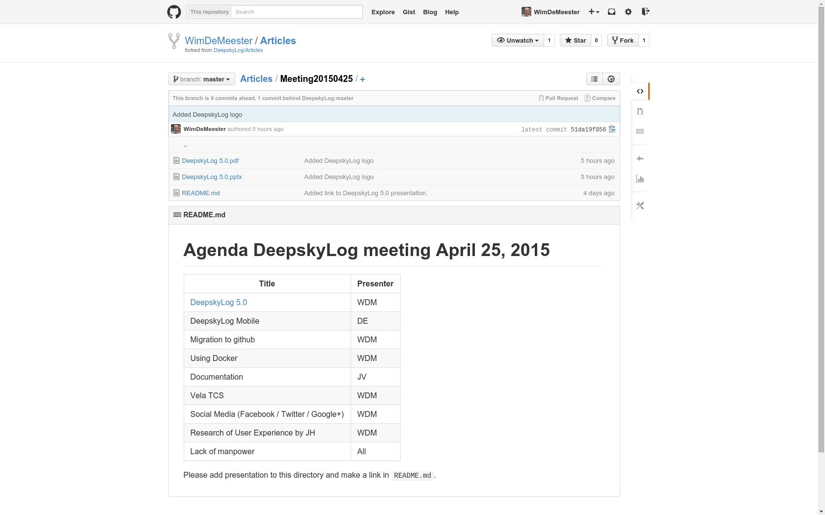

Slide 10
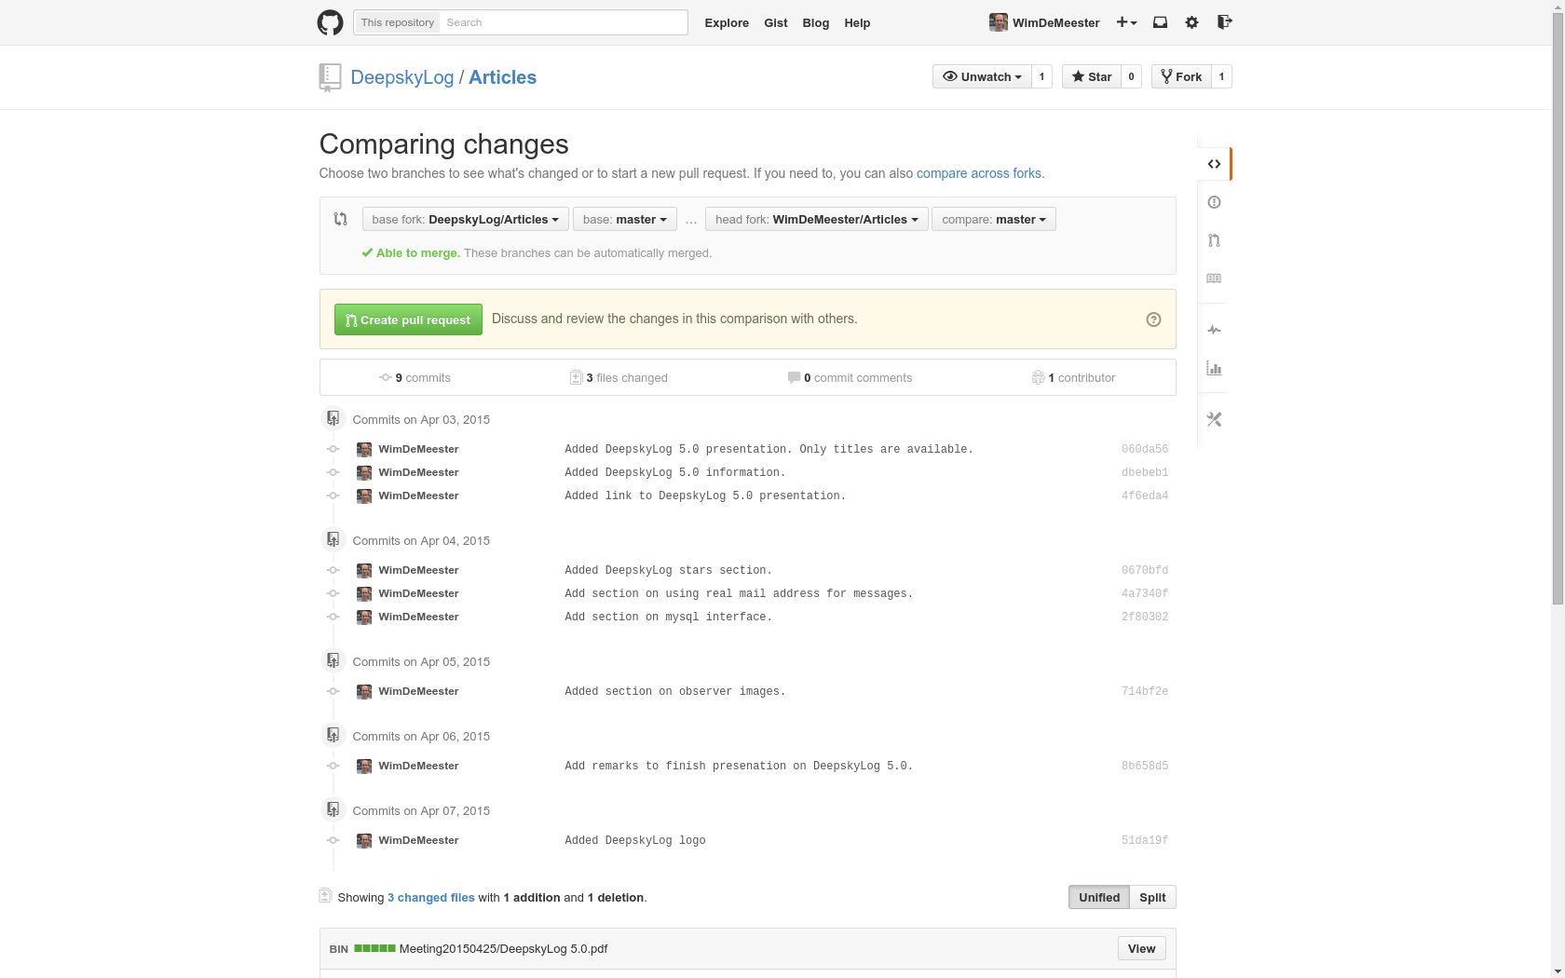

Slide 11
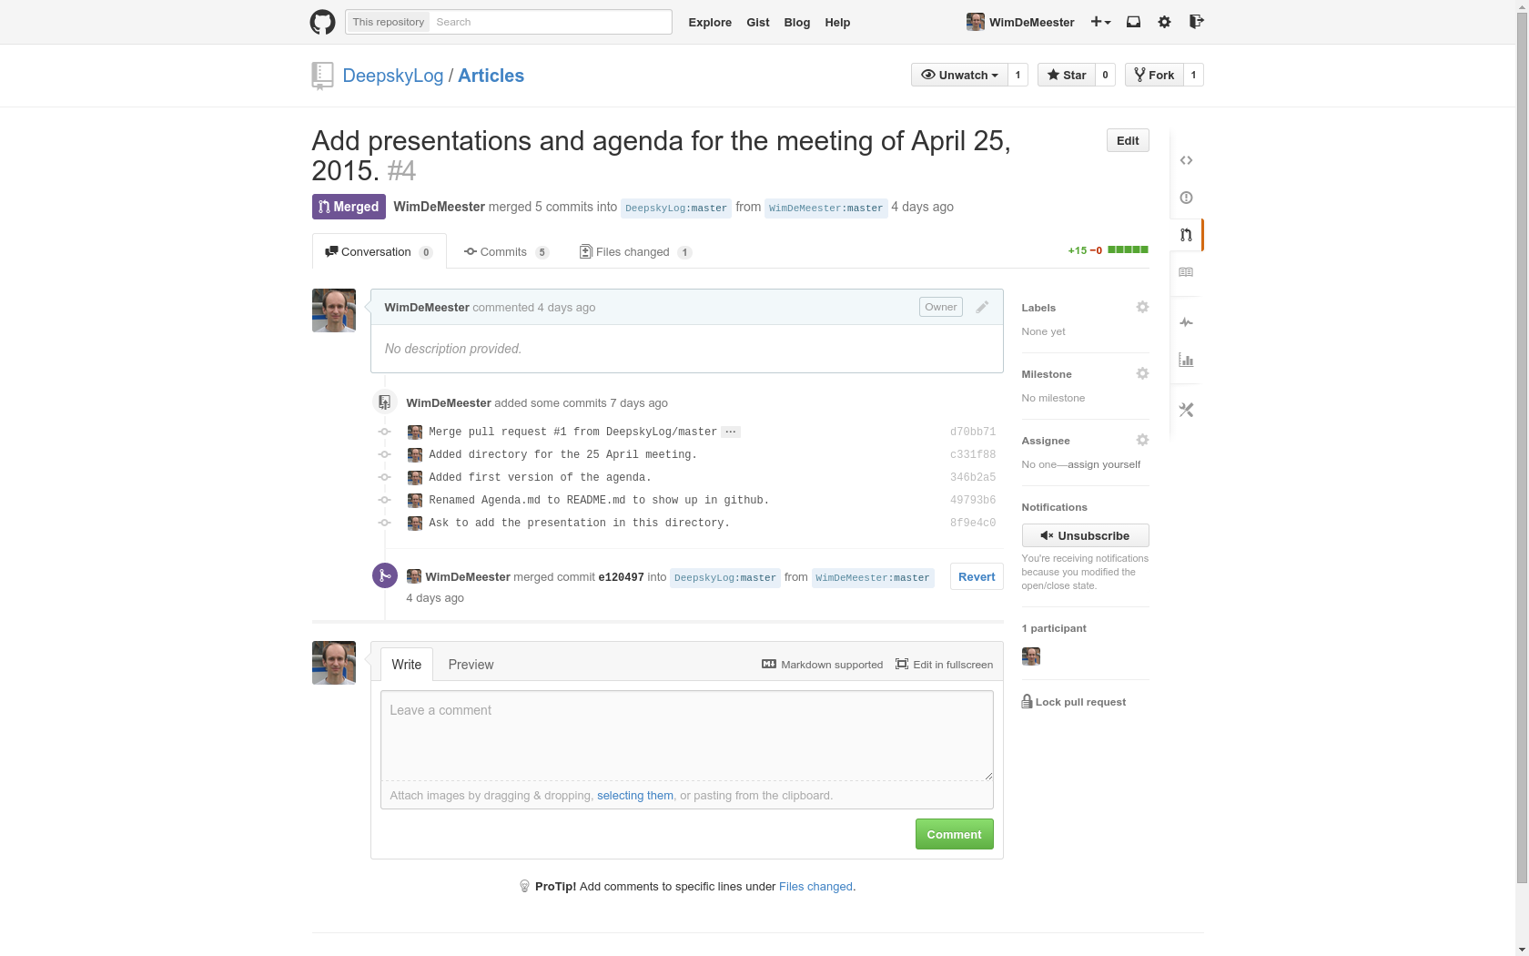

Slide 12
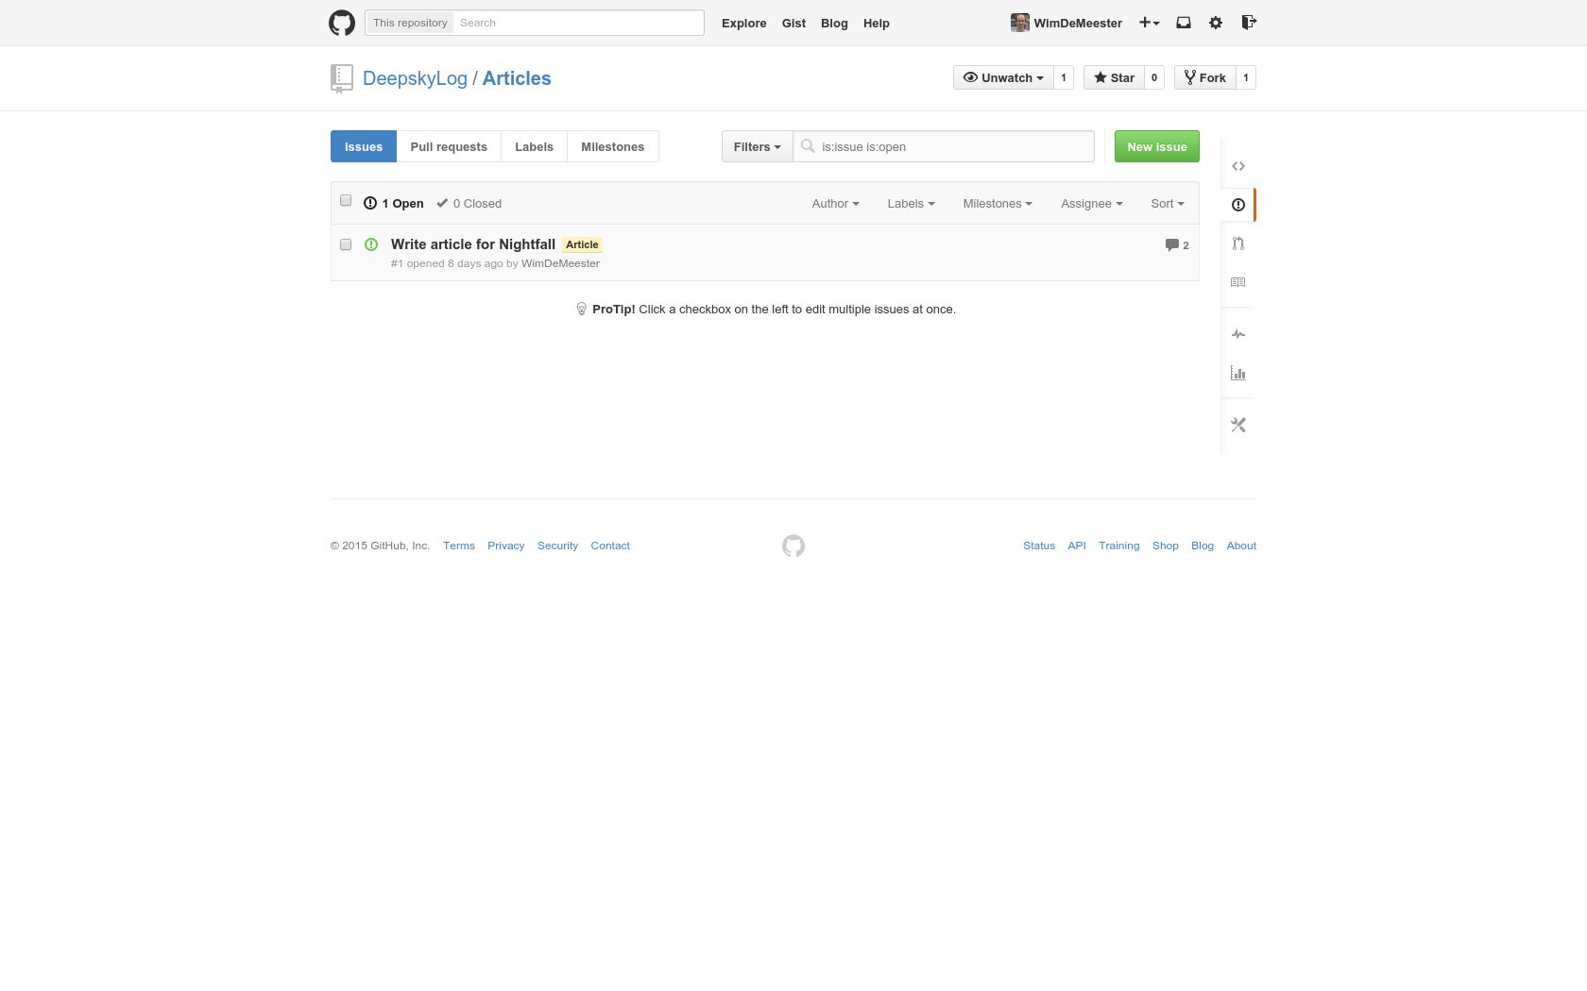

Slide 13
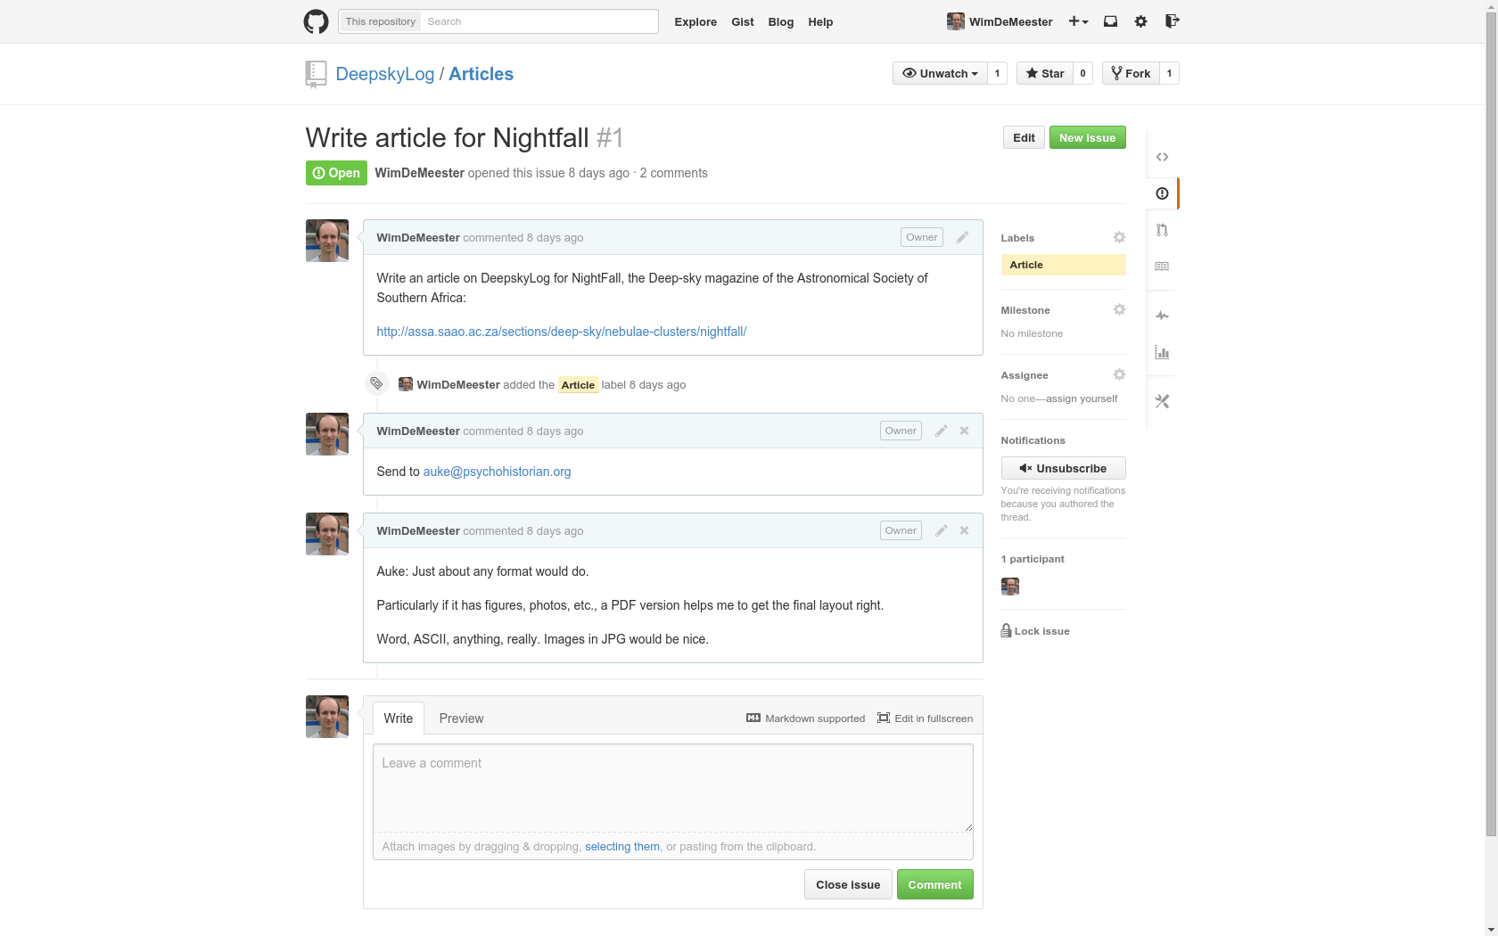

Slide 14
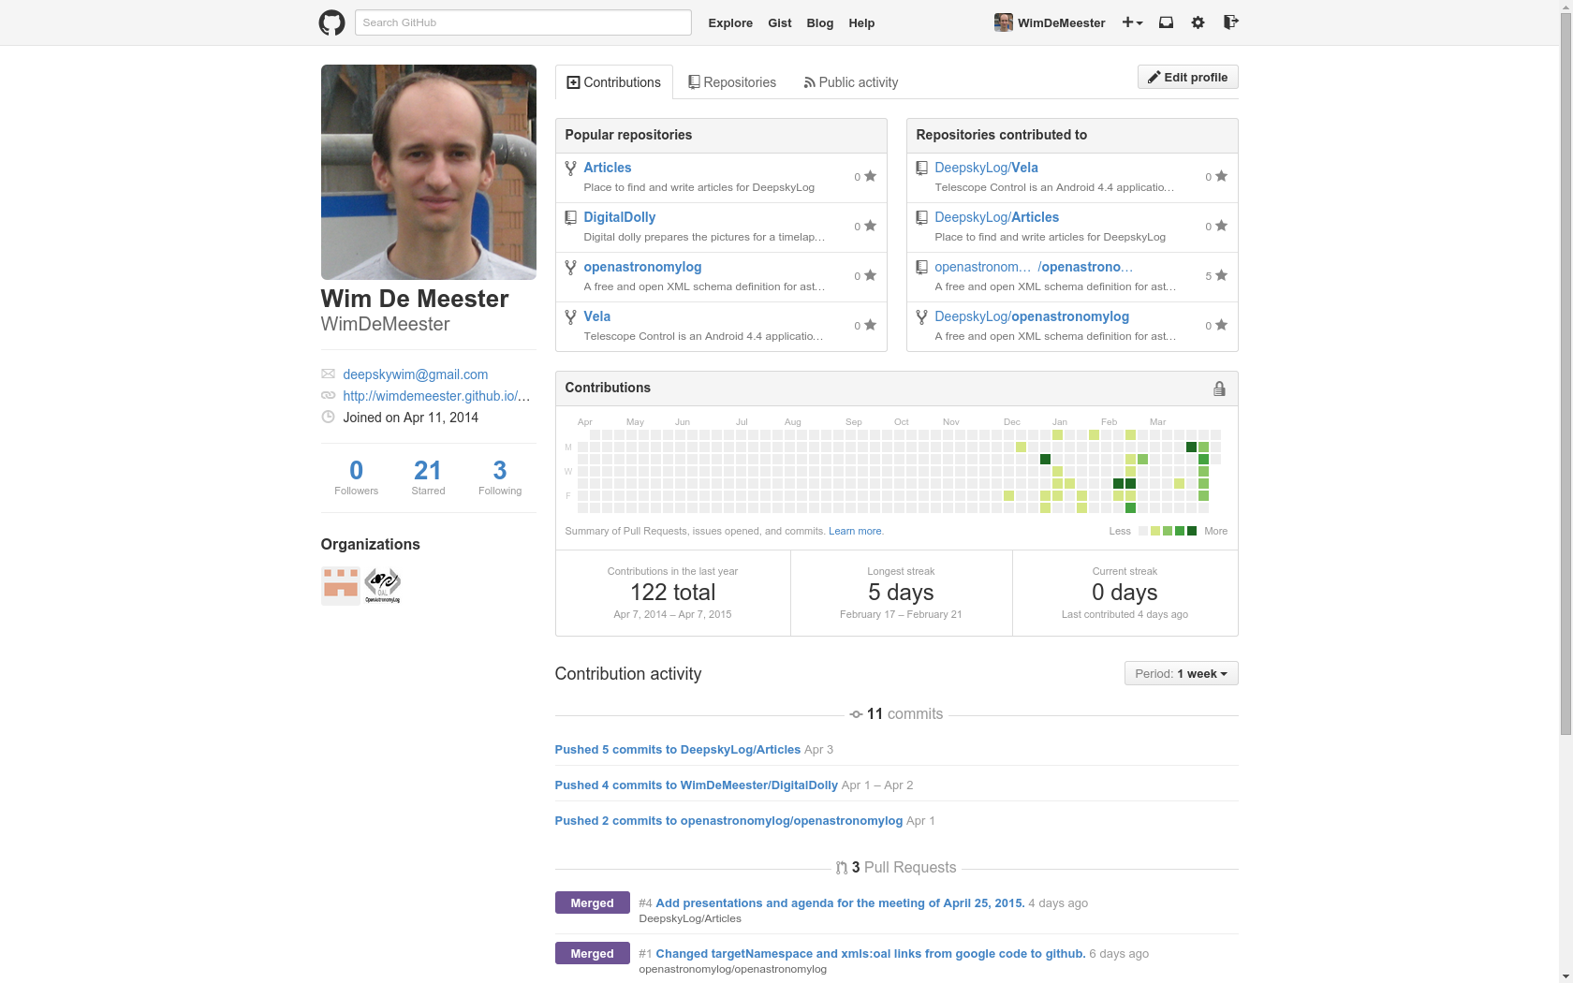

Slide 15
Positive points
Migration from svn
Including history
Migration of issues from redmine
Attracts other Developers
GitHub apps for Mac, Windows, Ios, Android
GitHub plugins for eclipse

Slide 16
Negative points
Redmine wiki can not be converted automatically

